Slide 1
Unsupervised Machine Learning-Capstone Project on
Online Retail Customer Segmentation
By
Sandipan Das

Slide 2
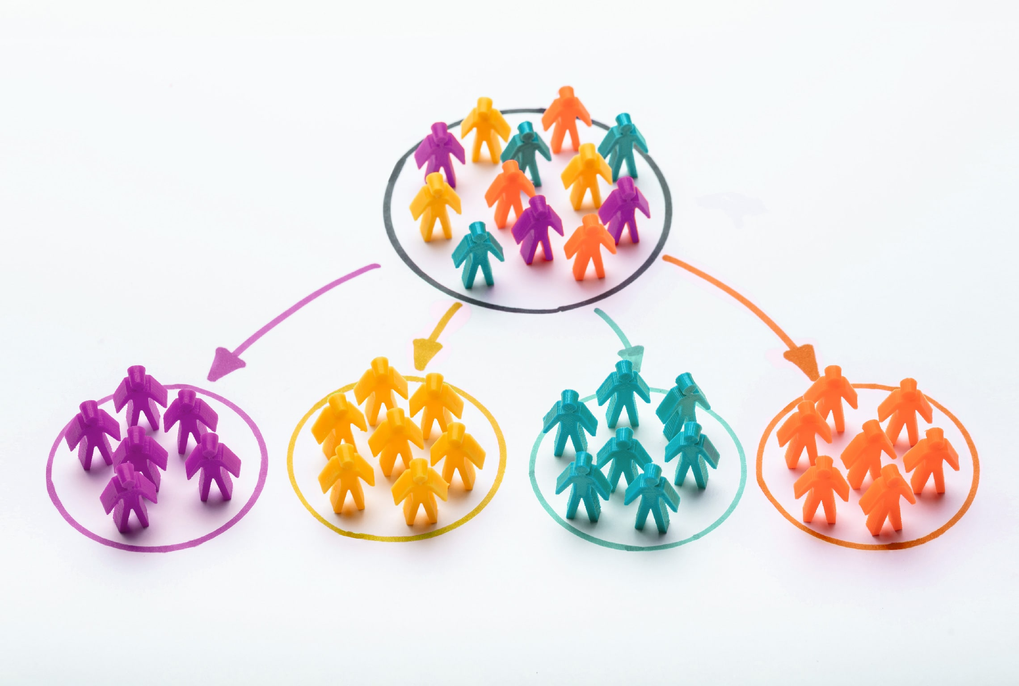
Online Retail Customer Segmentation
            Customer segmentation is a way to split customers into groups based on certain characteristics that those customers share. All customers share the common need of your product or service, but beyond that, there are distinct demographic differences (i.e., age, gender) and they tend to have additional socio-economic, lifestyle, or other behavioral differences that can be useful to the organization.
            ?

Slide 3
Points of Discussion
1. Problem Statements
2. Understanding Dataset
3. Data Preparation
4. Exploratory Data Analysis
5. Key Findings & Conclusions from EDA
6. DATA PREPARATION FOR RFM SEGMENTATION
7.Implementing K-Means clustering and Hierarchical Clustering
8.Conclusion

Slide 4
Problem Statement
In this project, your task is to identify major customer segments on a transnational data set which contains all the transactions occurring between 01/12/2010 and 09/12/2011 for a UK-based and registered non-store online retail. The company mainly sells unique all-occasion gifts. Many customers of the company are wholesalers.

Slide 5
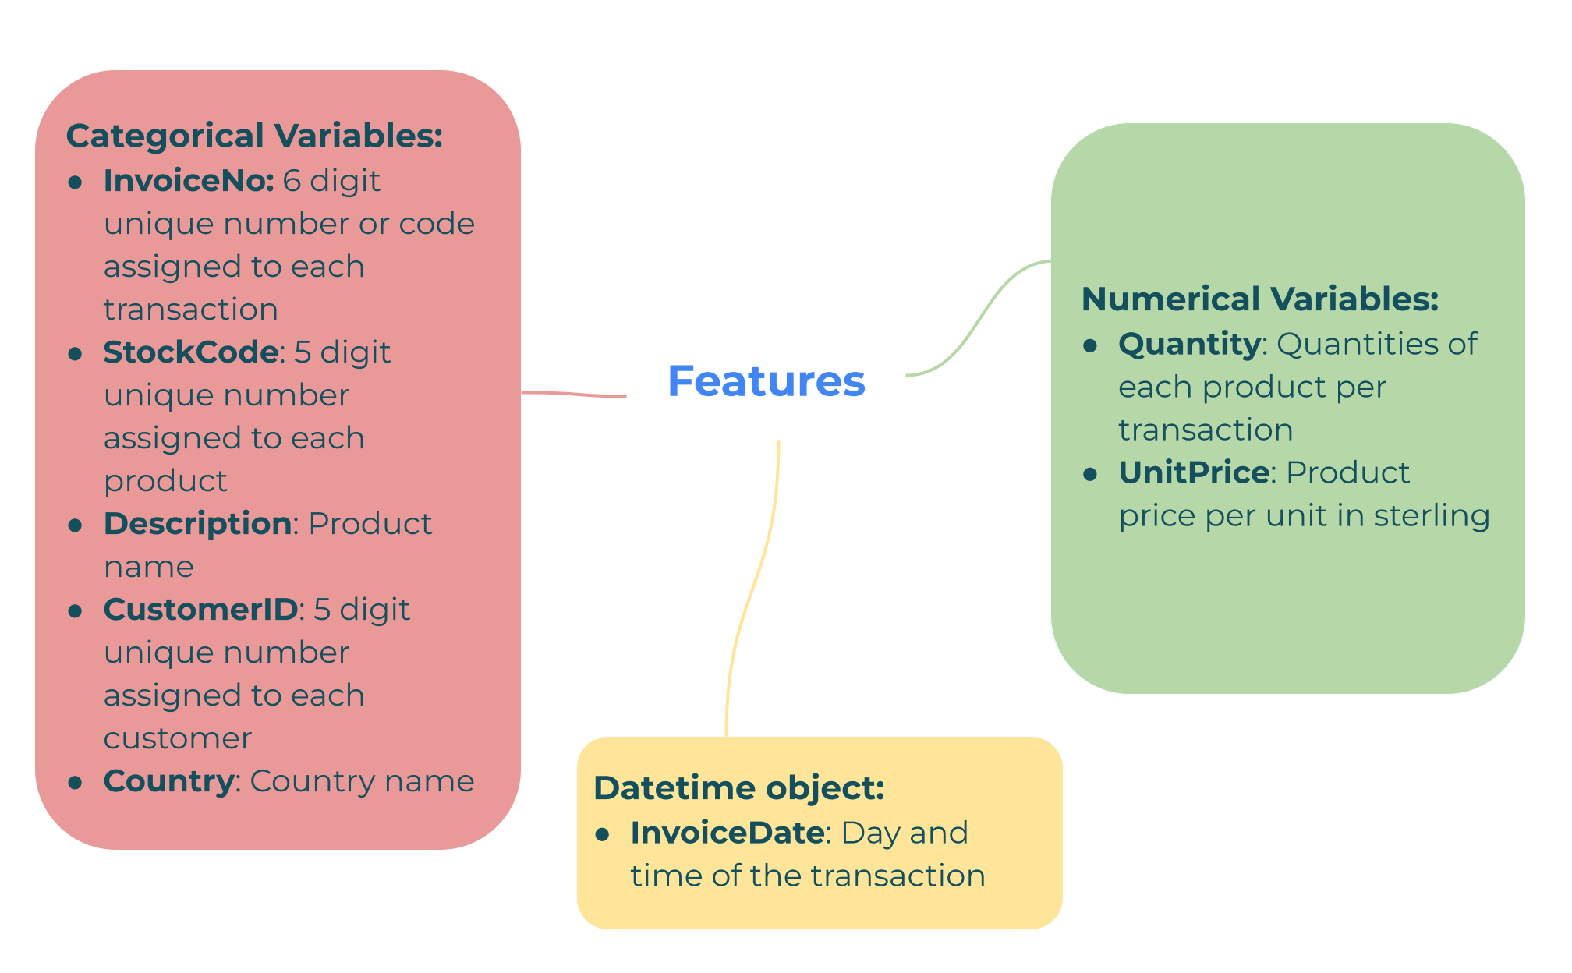
Understanding the Variables

Slide 6
Data Preparation
1.We removed all the rows containing duplicated values from the dataset.
2. We removed all the rows containing null values from the dataset.
3. We removed all the rows containing cancelled invoice numbers from the dataset.
4. We extracted new features such as weekday, year, month and hour from invoice date column.
5.We created a new column Total amount from unit price and quantity.
6.We treated outliers from our dataset using z-score.

Slide 7

Exploratory Data Analysis
Exploratory data analysis (EDA) is used by data scientists to analyze and investigate data sets and summarize their main characteristics, often employing data visualization methods.

Slide 8
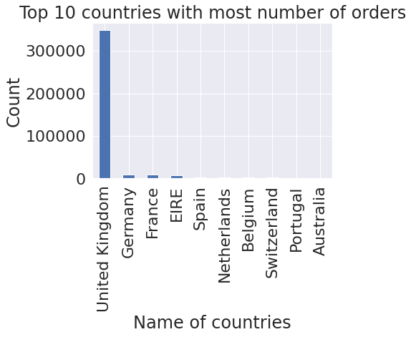
Top 10 countries with most number of orders
The graph shows that the majority of orders come from the United Kingdom, followed by Germany and France, indicating that online retail store is very common in Europe.

Slide 9
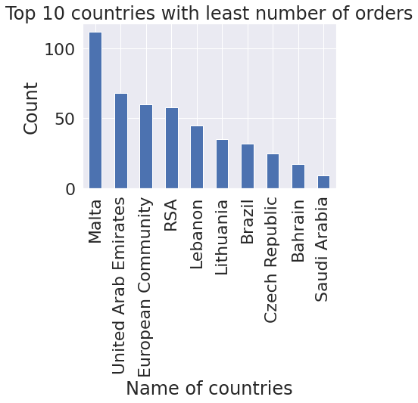
Top 10 countries with least number of orders
According to the graph, the least number of orders come from the Saudi Arabia, followed by Bahrain, indicating that online retail store has very few customers from the Middle East.

Slide 10
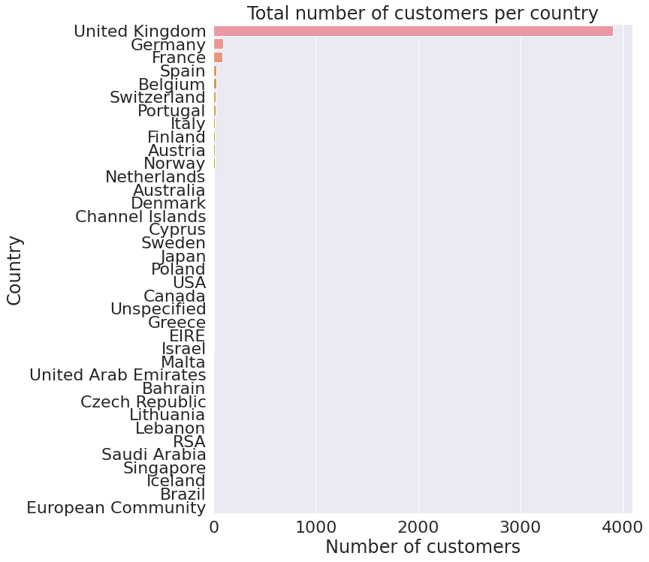
Number of Customers from different countries
It is clearly visible from the data and the graph that UK has the most number of customers followed by Germany and France. It can be assumed that Europe is the most dominated area.

Slide 11
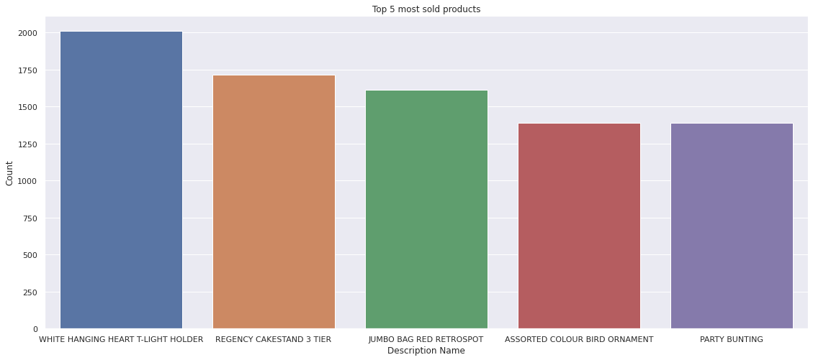
Most Selling products
The top 5 most sold products are:
White Hanging Heart T-Light Holder
Regency Cakestand 3 Tier
Jumbo Bag Red Retrospot
Assorted Colour Bird Ornament
Party Bunting

Slide 12
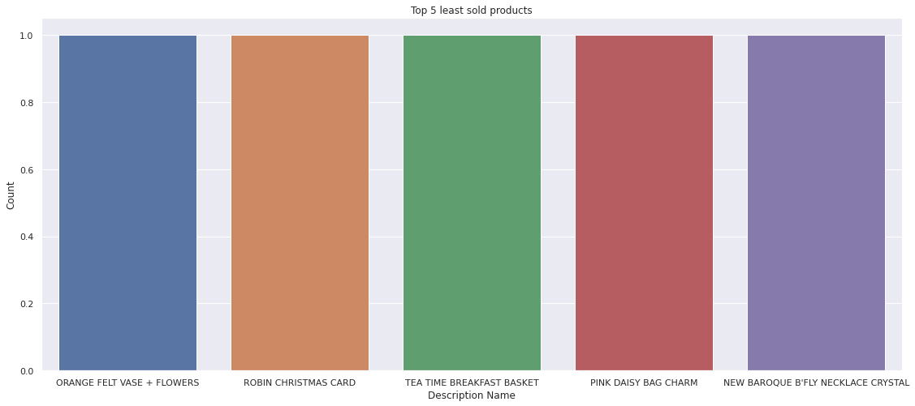
Which products are the least sold ones?
The top 5 least sold products are:
Green with Metal Bag Charm,
White with Metal Bag Charm,
Blue/Nat Shell Necklace W Pendant,
Pink Easter Hens + Flower
Paper Craft, Little Birdie
(each of 1 unit)

Slide 13
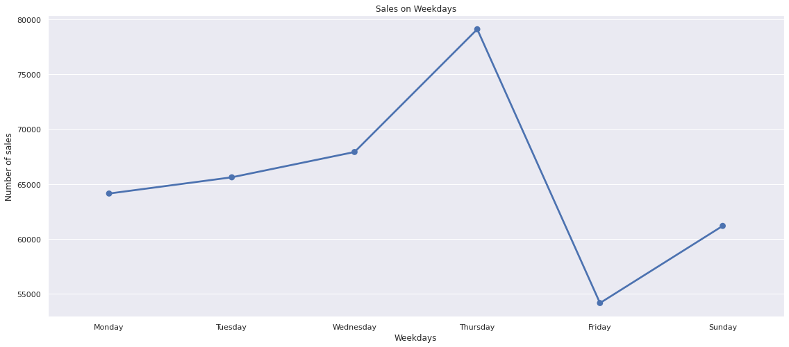
Amount of sales in days of week
We can see that sales is highest at Thursday and lowest in Friday.

Slide 14
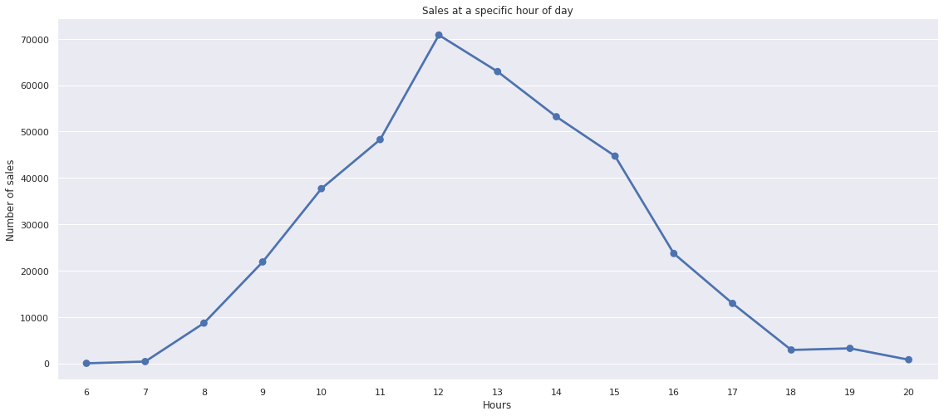
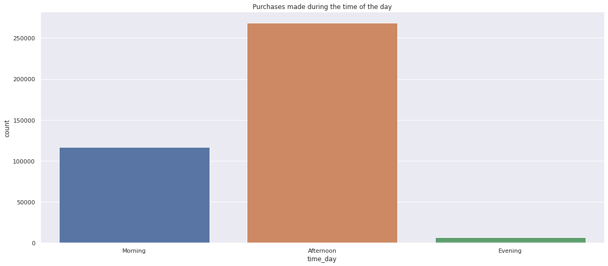
Looking at sales at specific hour of the day
We can see that Sales is highest during the afternoon period (between 11:00 AM and 3:00 PM)

Slide 15
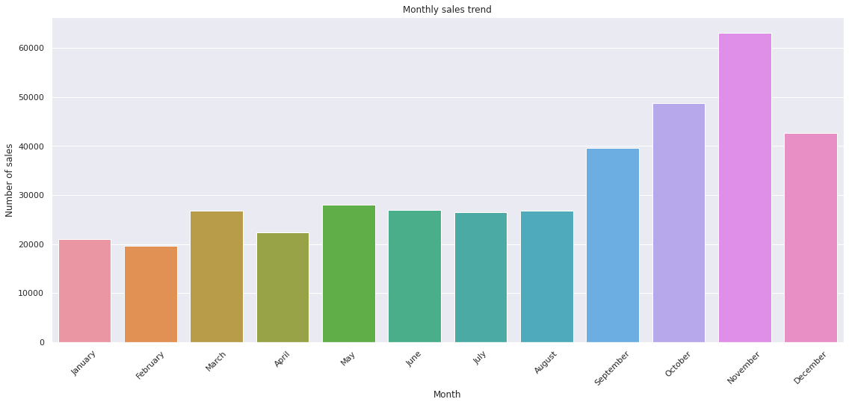
Visualizing the Monthly Sales Trend
We can clearly see that Sales is highest during the November month followed by October.

Slide 16
DATA PREPARATION FOR RFM SEGMENTATION
RFM segmentation (Recency, Frequency, Monetary) is a tried-and-true marketing model for behavior-based customer segmentation. It categorises customers based on their purchase history - how recently, how frequently, and how much they purchased. Therefore in this project, I will be performing RFM segmentation using unsupervised machine learning.
RFM segmentation helps in categorising customers and identifying customers who are more likely to respond to promotions as well as future personalisation services.

Slide 17
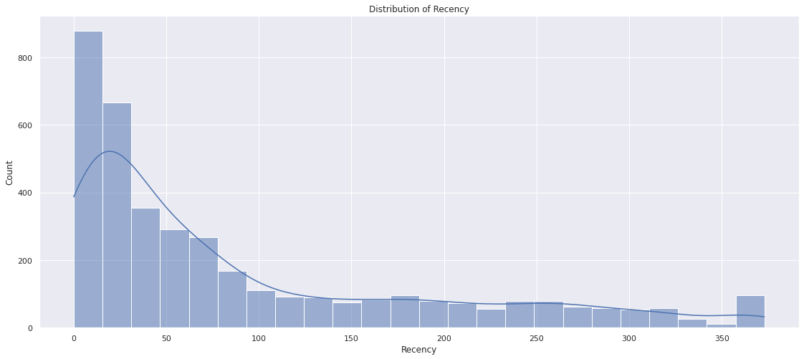
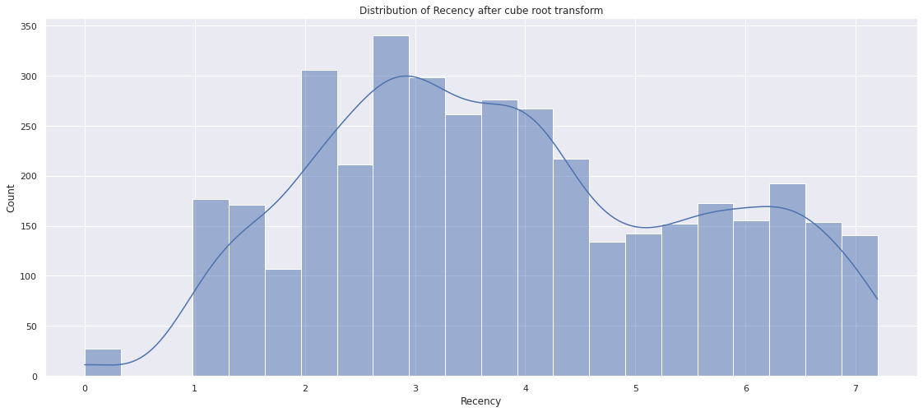
Plotting the distribution of Recency, Frequency and Monetary Value

Slide 18
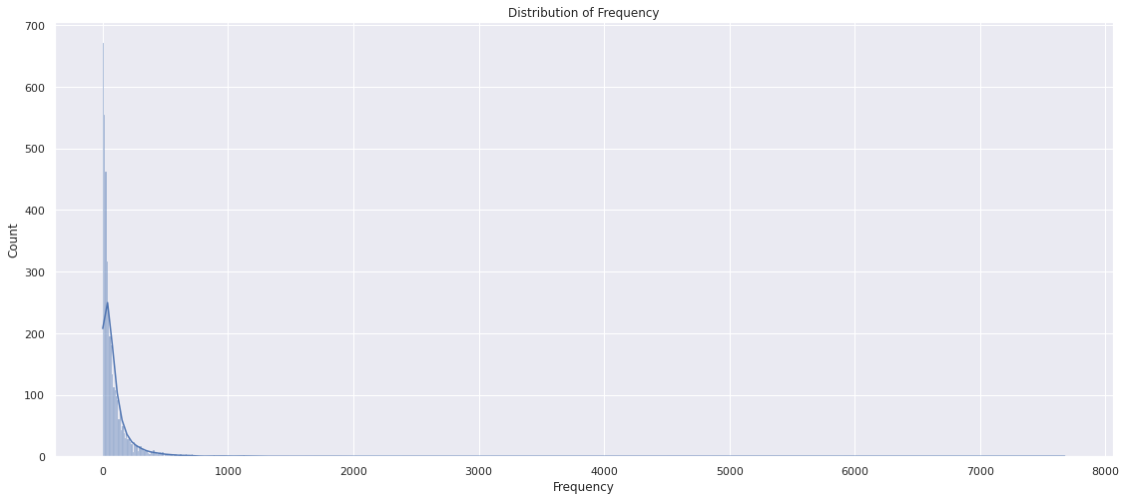
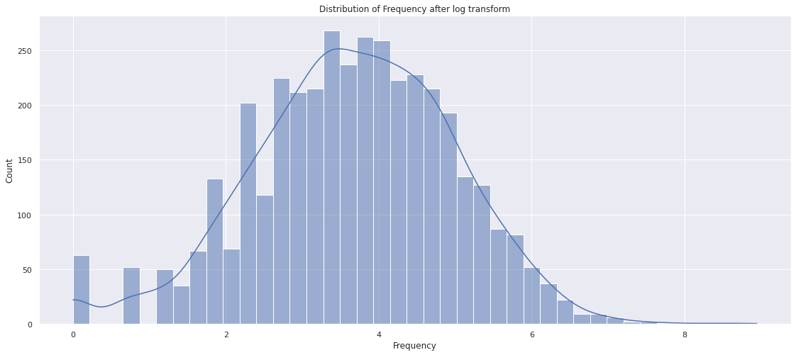
Distribution of frequency after log transformation

Slide 19
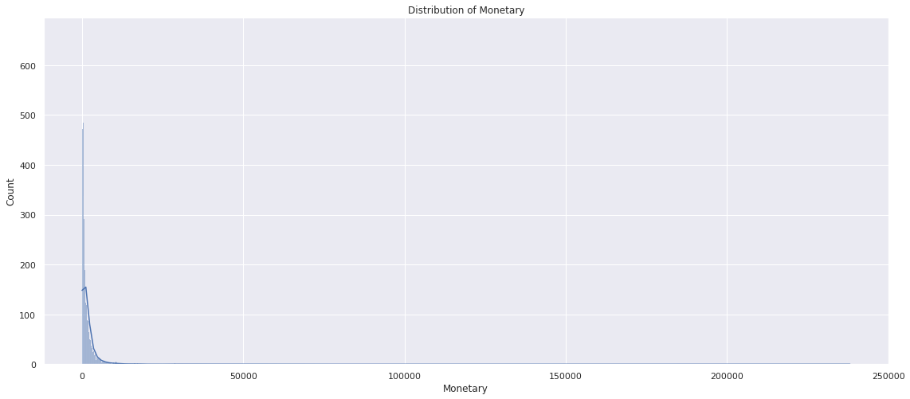
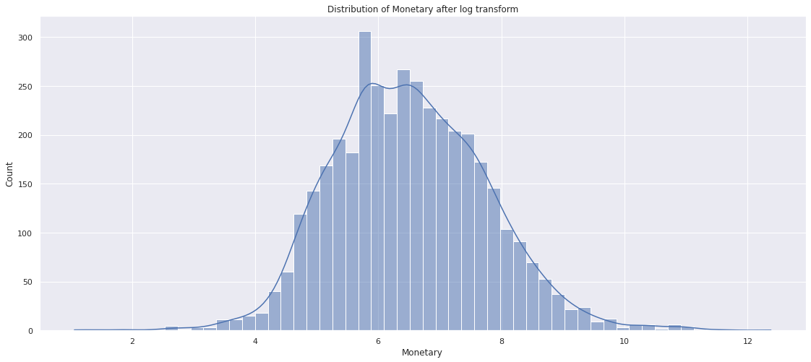
Distribution of monetary after log transformation

Slide 20
K-Means Clustering
The K-Means clustering algorithm computes centroids and repeats until the optimal centroid is found. It is presumptively known how many clusters are there. In this method, the data points are assigned in such a way that the sum of the squared distances between the data points and the centroid is as small as possible. K-Means implements the Expectation-Maximization strategy to solve the problem.

Slide 21
Evaluation Metrics
Silhouette Score: Silhouette score is used to evaluate the quality of clusters created using clustering algorithms in terms of how well samples are clustered with other samples that are similar to each other. The silhouette score is calculated for each sample of different clusters.
Elbow Method: A commonly used method for finding optimal K value is the Elbow method. For different values of K, the elbow method calculates WCSS which is the sum of squared distance between each point and the centroid in a cluster. When we plot the WCSS with the K value, the plot looks like an elbow. The point at which the graph changes rapidly is the optimal K value.

Slide 22
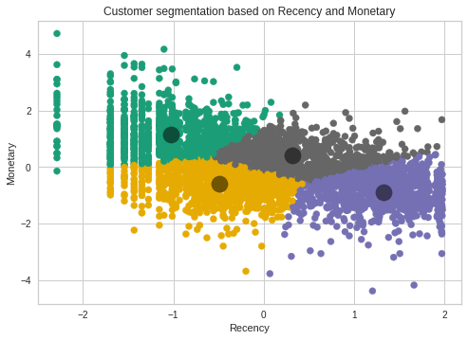
Implementing K means clustering
From the silhouette score method and elbow method we have found out that the optimal number of clusters is 4. Implementation of the final model for Recency and Monetary with number of clusters as 4.
1.Tier 4 customers (Yellow Points): These customers haven't made any purchase recently AND have not contributed more monetarily as well.
2.Tier 2 Customers (GREY POINTS): These customers contributed moderately both in terms of monetary and recency
3.Tier 3 customers (BLUE Points): These customers contributions are less monetarily but they are high on recency.
4.Tier 1 customers (Green Points): These customers contributed low on recency but high monetarily.

Slide 23
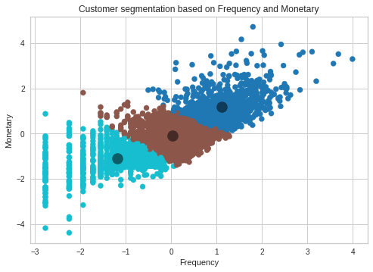
From the silhouette analysis and elbow method we reach to the conclusion that the optimal number of clusters is 3 for Frequency and Monetary values. We will run the model again with number of clusters as 3.
1.Tier 3 customers (Light Blue Points): These are relatively new or very rarely purchasing customers and contribute very less monetarily.
2.Tier 2 customers (Brown): These customers purchase more frequently than one time customers and contribute moderately in terms of money.
3.Tier 1 Customers (Dark Blue points): These customers are the most frequent and contribute more monetarily.

Slide 24
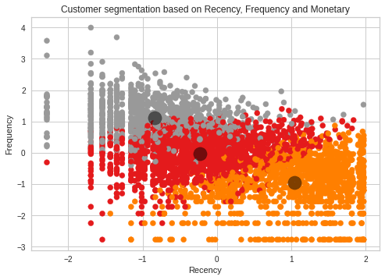
From the silhouette score and elbow method again we reach the conclusion that the optimal number of clusters is 3 for Recency, Frequency and Monetary values. We will again run the model with number of clusters as 3.
1.Tier 3 Customers (Orange Points): These customers are the most recent buyers but the frequency was very less.
2.Tier 2 Customers (Red Points): These customers are not the most frequent ones or recent ones.
3.Tier 1 Customers (Grey Points): These are the new customers who have not made their purchases very recently but were the most frequent customers.

Slide 25
HIERARCHIAL CLUSTERING
Hierarchical clustering is an algorithm that groups similar objects into groups called clusters. The endpoint is a set of clusters, where each cluster is distinct from other clusters, and the objects within each cluster are broadly similar to each other. The main output of hierarchical clustering is a dendrogram, which shows the hierarchical relationship between the clusters.

Slide 26
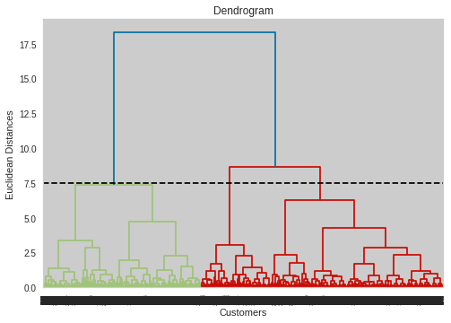
Implementation of Hierarchial Clustering
The Dendogram indicates that the number of clusters should be three. As a result, we will partition the customers into three groups using Hierarchical Clustering.

Slide 27
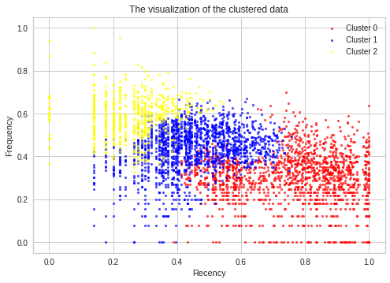
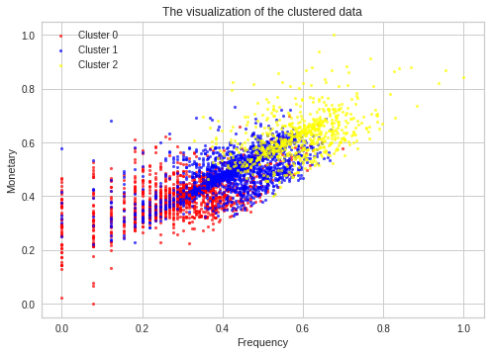
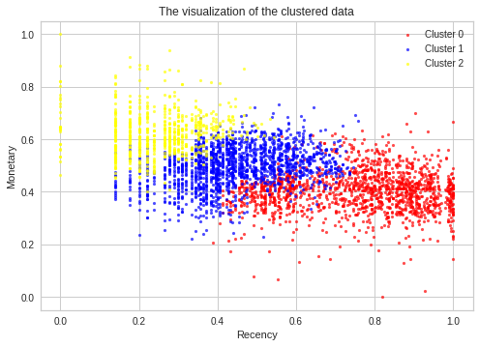
Model Implementation

Slide 28
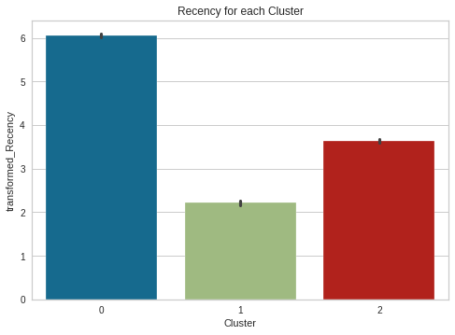
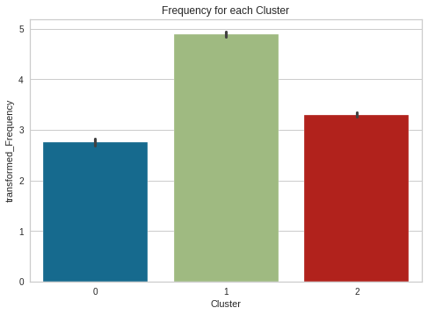
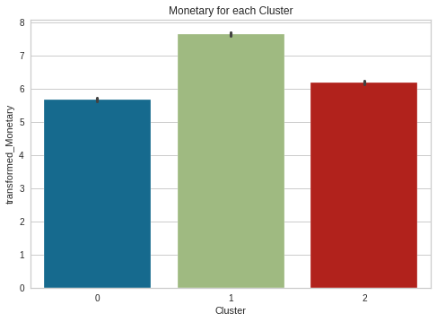
Analysing the clusters
1.Tier 1 customers, who buy frequently from the store, spend a significant amount of money but have not recently purchased.
2.Tier 2 customers make up Cluster 2, which are moderate-level customers who buy from the store on a regular basis, spend a reasonable amount of money, but haven't bought from the store in a while.
3. Cluster 0 consists of Tier 3 customers who shop infrequently, spend less money, but have purchased from the store recently.

Slide 29
Challenges
1. Handling large dataset.
2. Dealing with columns which contains large number of categories.
3. Treatment of null values and outliers.
4. Treatment of skewness
5. Analysing the clusters and drawing conclusions

Slide 30
Conclusions from EDA
1. There are 37 different countries present in our dataset with United Kingdom holding the most number of orders followed by followed by Germany and the least number of orders are placed from countries like Saudi Arabia, Bahrain. It can be assumed that European sector is doing well from the beginning and companies should make strategies to make sales more in Middle East Countries.
2. As the number of orders are more from United Kingdom , the number of customers are also more as well from here only.
3.The demand of WHITE HANGING HEART T-LIGHT HOLDER is more as compared to the other products. It can be well assumed that the quality of this product might be good along with its requirement in the European sector as most of the sales are generated from there only. It can be a type of a warm cloth as weather in Europe is comparatively cooler the other parts.
4. The demand of NEW BAROQUE B'FLY NECKLACE CRYSTAL is the lowest followed by PINK DAISY BAG CHARM . It is clearly visible that Women's usable products demands are very less. It might be Women might not be very much comfortable with online shopping.
5. From the weekly daily sales we can see that sales are more in weekdays and along with that the timing of the sales is more during the afternoon time. It can be well assumed that during workingdays when people get break for lunch during afternoon at that time they place their orders.
6. Sales are more during the month of November might be due to Christmas as Christmas shopping takes place even in places like Germany Tollwood winter festival takes place.

Slide 31
Conclusions from ML
1. As we can see that tier 1 customers are the one whose buying freqency is high along with a good monetary spending but their recency is low that means they are not recently purchasing. Stores should find out the reason behind their less recent purchases and should take steps to increase it.
2. As we can see that tier 2 customers performed moderately on both monetary terms and are frequent buyerof the products but they also not have purchased products recently. Stores should find out the reason behind their less recent purchases and should take steps to increase it.
3. As we can see that tier 3 customers did not contribute monetarily and they were not also frequent buyers but they started purchasing recently. So stores should figure out what different they did with tier 3 customers and try to implement the same withtier 1 and tier 2 customers as well to increase recency.

Slide 32
Thank You

